Slide 1
Optimising Galaxy Formation and Evolution Models
Mawson Sammons
Supervisor: Rodrigo Tobar
and Dr Claudia lagos

Slide 2
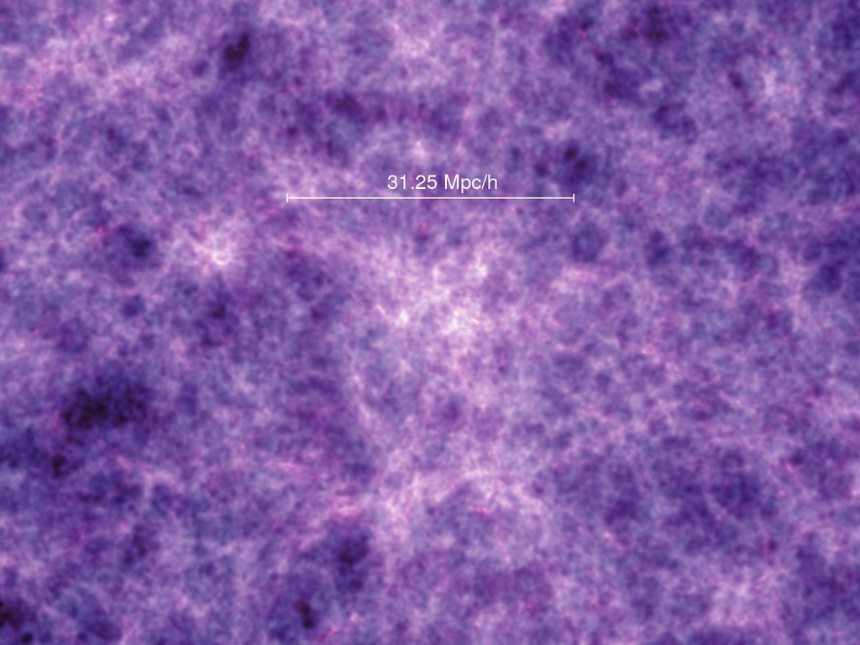
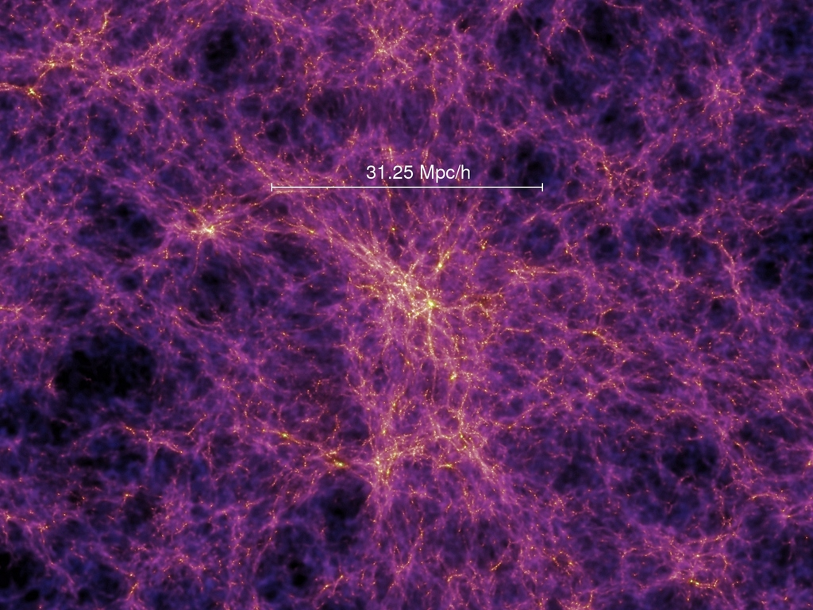
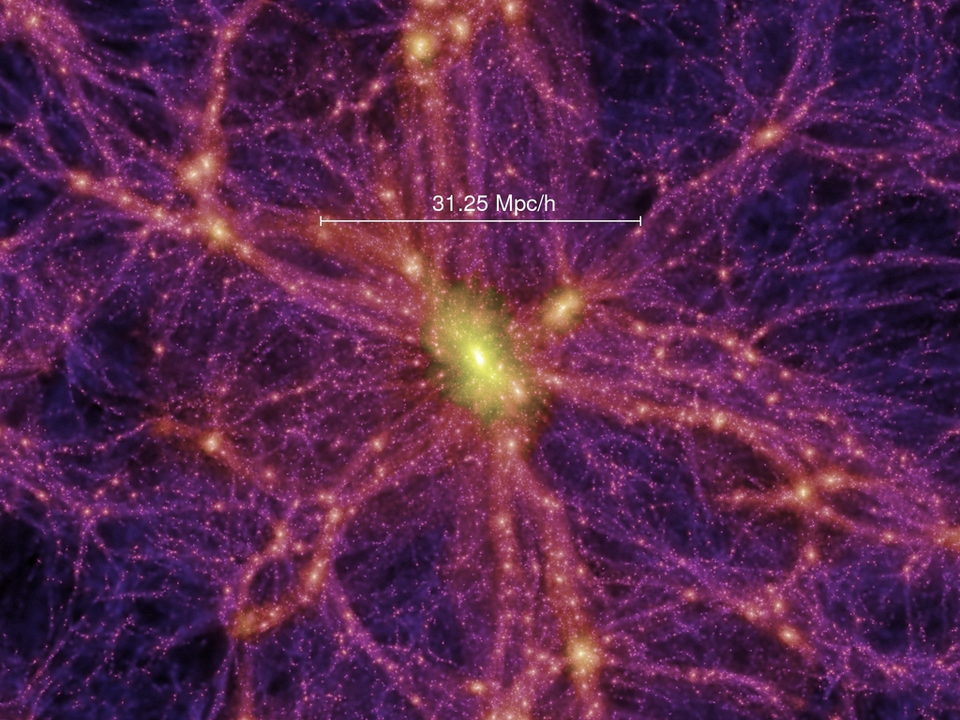
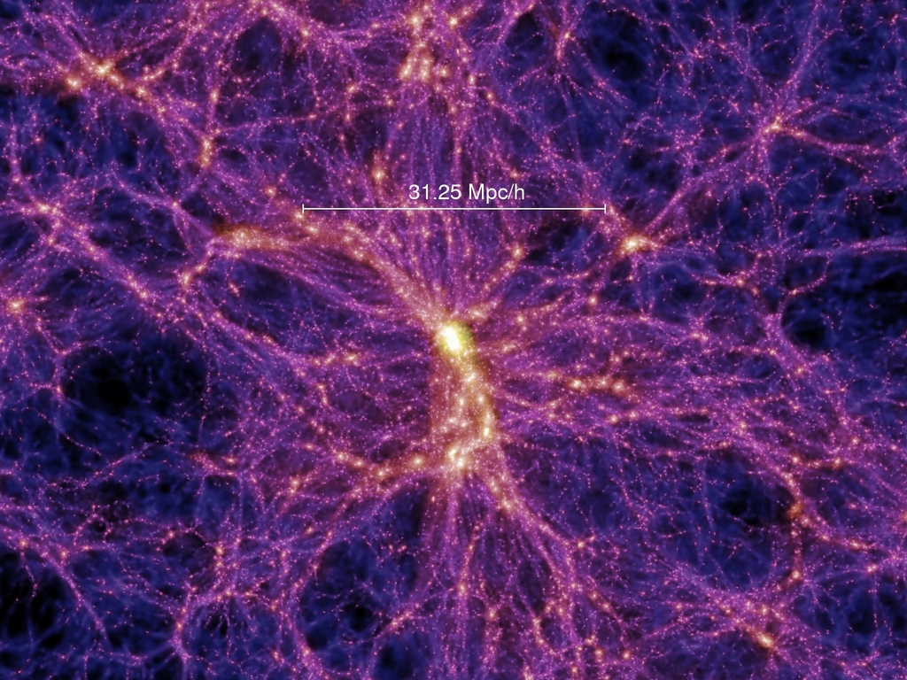
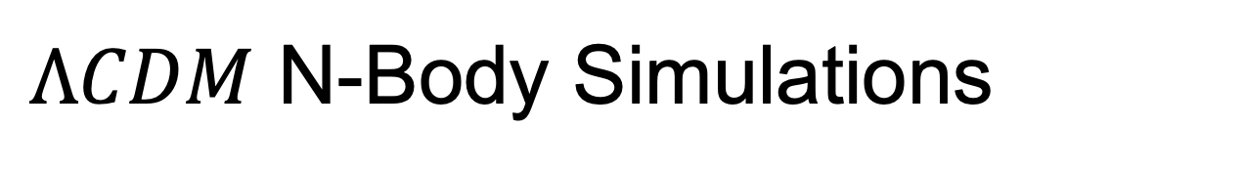
$ΛCDM$ N-Body Simulations

Slide 3
Group Finding - VELOCIraptor

Slide 4
Group Finding - VELOCIraptor

Slide 5
Group Finding - VELOCIraptor

Slide 6
Group Finding - VELOCIraptor

Slide 7
Group Finding - VELOCIraptor

Slide 8
Group Finding - VELOCIraptor

Slide 9
Group Finding - VELOCIraptor

Slide 10
Group Finding - VELOCIraptor

Slide 11
Group Tracking - TREEFROG

Slide 12
Group Tracking - TREEFROG

Slide 13
Group Tracking - TREEFROG

Slide 14
Group Tracking - TREEFROG

Slide 15
Group Tracking - TREEFROG

Slide 16
Group Tracking - TREEFROG

Slide 17
Group Tracking - TREEFROG

Slide 18
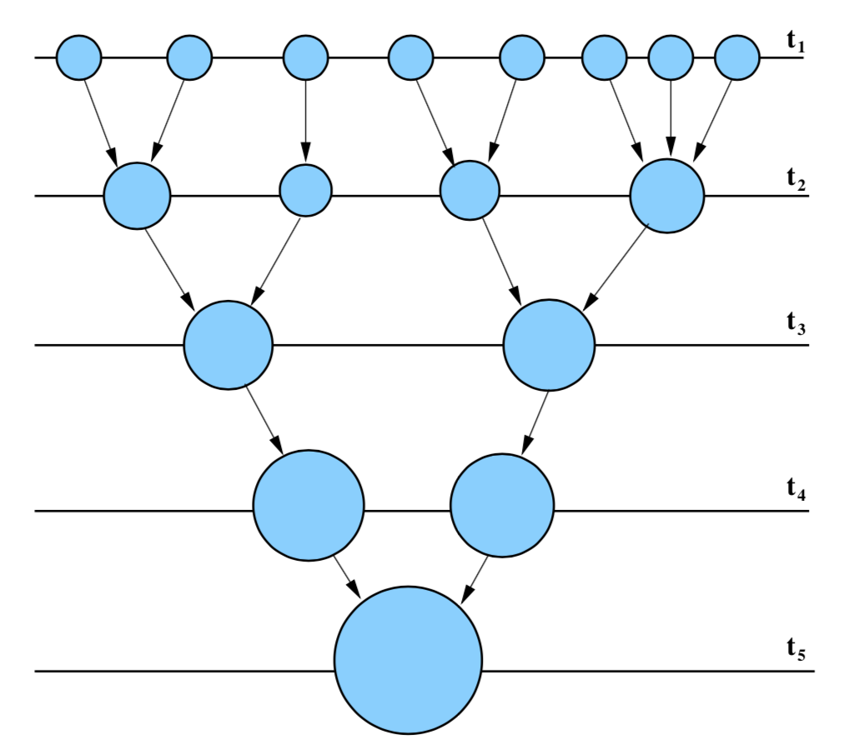
Merger Trees

Slide 19
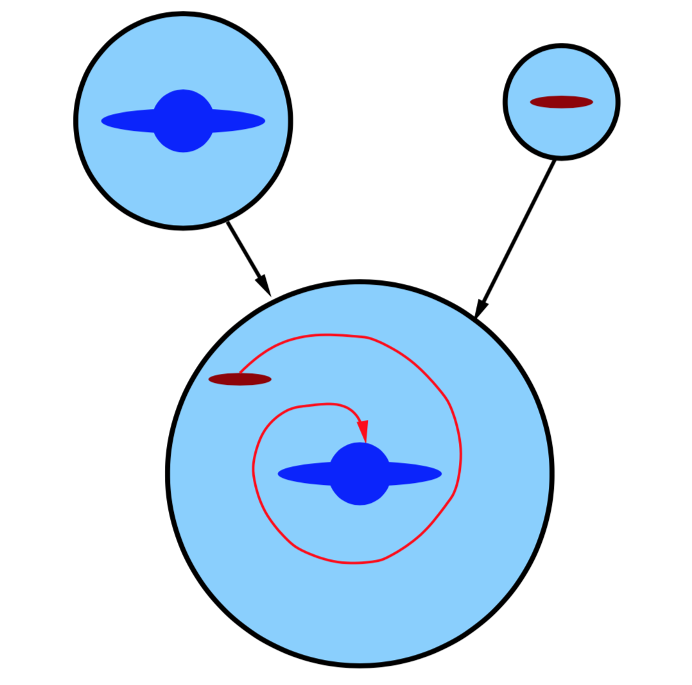
Semi-Analytical Models (SAMs)
SHARK
Physical Processes:
Gas cooling in halos
Stellar formation
Stellar feedback
Black hole feedback
Galaxy mergers
Disk instabilities
Photoionisation feedback
Environmental effects
Etc…

Slide 20
References
Springel, Volker, Simon D. M. White, Adrian Jenkins, Carlos S. Frenk, Naoki Yoshida, Liang Gao, and Julio Navarro et al. 2005. "Simulations Of The Formation, Evolution And Clustering Of Galaxies And Quasars". Nature 435 (7042): 629-636. doi:10.1038/nature03597.
Ruiz, Andrés N., Sofía A. Cora, Nelson D. Padilla, Mariano J. Domínguez, Cristian A. Vega- Martínez, Tomás E. Tecce, and Álvaro Orsi et al. 2015. "CALIBRATION OF SEMI-ANALYTIC MODELS OF GALAXY FORMATION USING PARTICLE SWARM OPTIMIZATION". The Astrophysical Journal 801 (2): 139. doi:10.1088/0004-637x/801/2/139.
Lagos, Claudia del P, Rodrigo J Tobar, Aaron S G Robotham, Danail Obreschkow, Peter D Mitchell, Chris Power, and Pascal J Elahi. 2018. "Shark: Introducing An Open Source, Free, And Flexible Semi-Analytic Model Of Galaxy Formation". Monthly Notices Of The Royal Astronomical Society 481 (3): 3573-3603. doi:10.1093/mnras/sty2440.
Baugh, C M. 2006. "A Primer On Hierarchical Galaxy Formation: The Semi-Analytical Approach". Reports On Progress In Physics 69 (12): 3101-3156. doi:10.1088/0034-4885/69/12/r02.

Slide 21
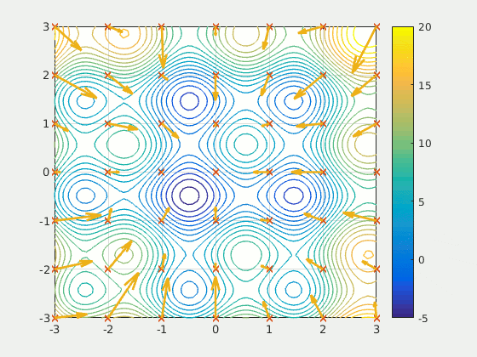
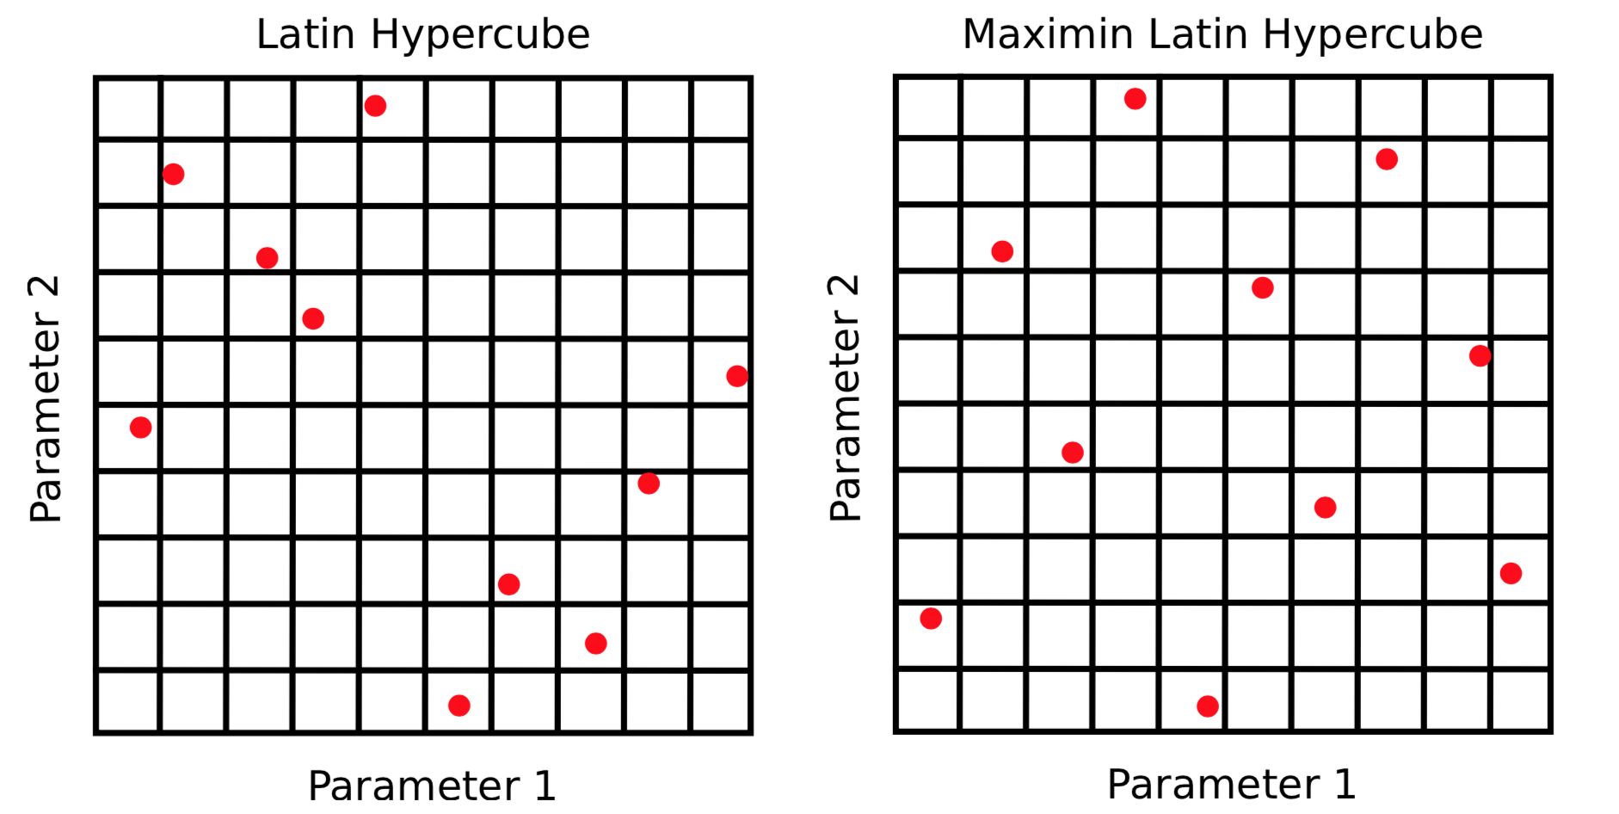
Particle Swarm Optimisation
$$V_{i}\left(t+1\right)=wV_{i}\left(t\right)+c_{1}ξ_{1}\left[B_{i}\left(t\right)−X_{i}\left(t\right)\right]+c_{2}ξ_{2}[G\left(t\right)−X_{i}\left(t\right)]$$
Initial Velocity
Acceleration towards current minimum
Acceleration towards global minimum

